Slide 1

Food Oasis Sprint 3: Hyperhex
Project Manager: Paulyn Monasterio
Scrum Master: Minhaj Shujauddin
Programmer I: Stephen Gilbert
Programmer II: Mike Fanor
Quality Assurance: Daniel Green

Slide 2
Overview of presentation
Completed Stories
Burndown Chart
Velocity Chart
Refresh on Food deserts
Product
Value
Test Scenarios
Backlog
Questions
Notes:
Minhaj’s slide

Slide 3
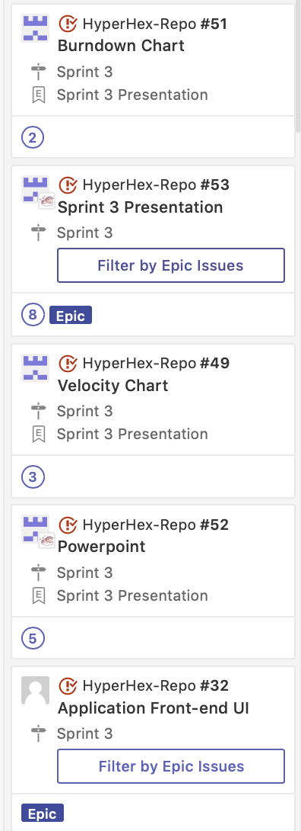
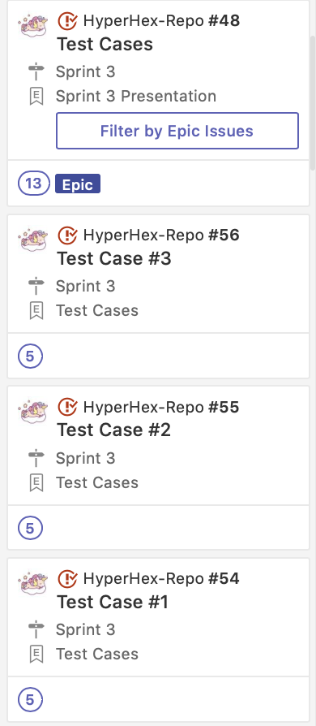
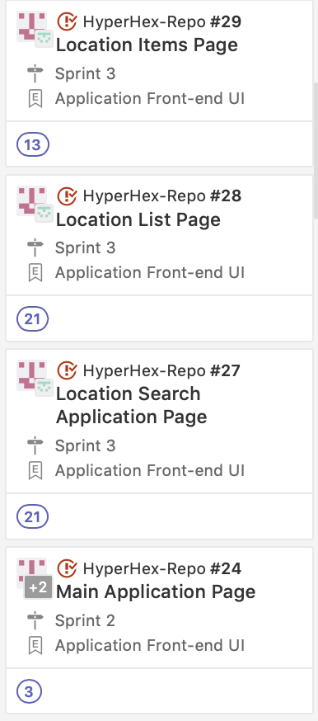
Completed Stories
Notes:
Paulyn’s Slide
These are all the stories we were able to complete in this sprint. This sprint was focused on finishing all of our xml pages which include,
-Location Items Page
-Location List Page
-Location Search Application Page
-The Main Application Page
As well as all the necessary components for this Presentation which include,
-All the test cases
-The power point
-Velocity Chart
-Burndown Chart

Slide 4
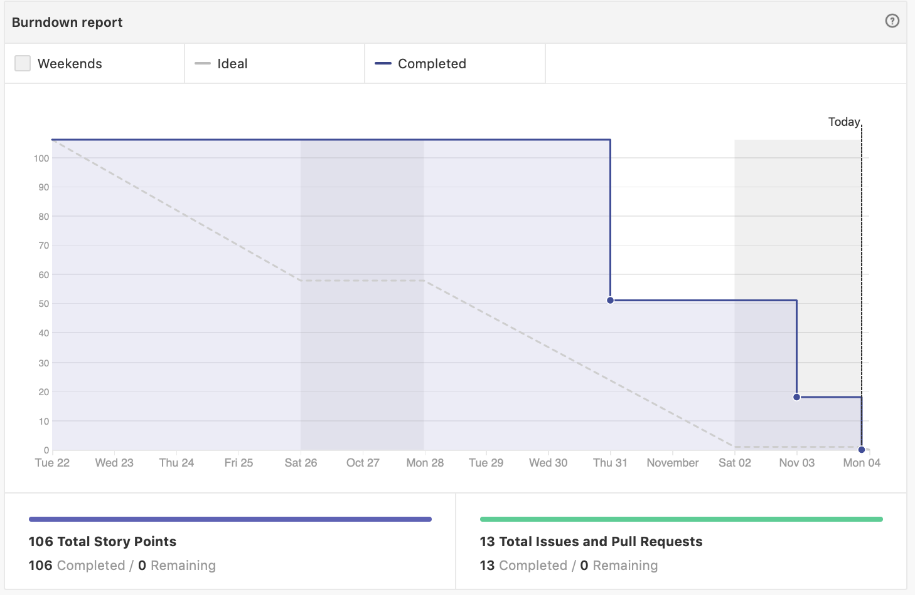
Burndown Chart
Notes:
Minhaj’s slide
This is our Burndown Chart
It may look a little flat in the beginning because…
We had a late start on this sprint but we were able to finish all of our story issues towards the end of our sprint.

Slide 5
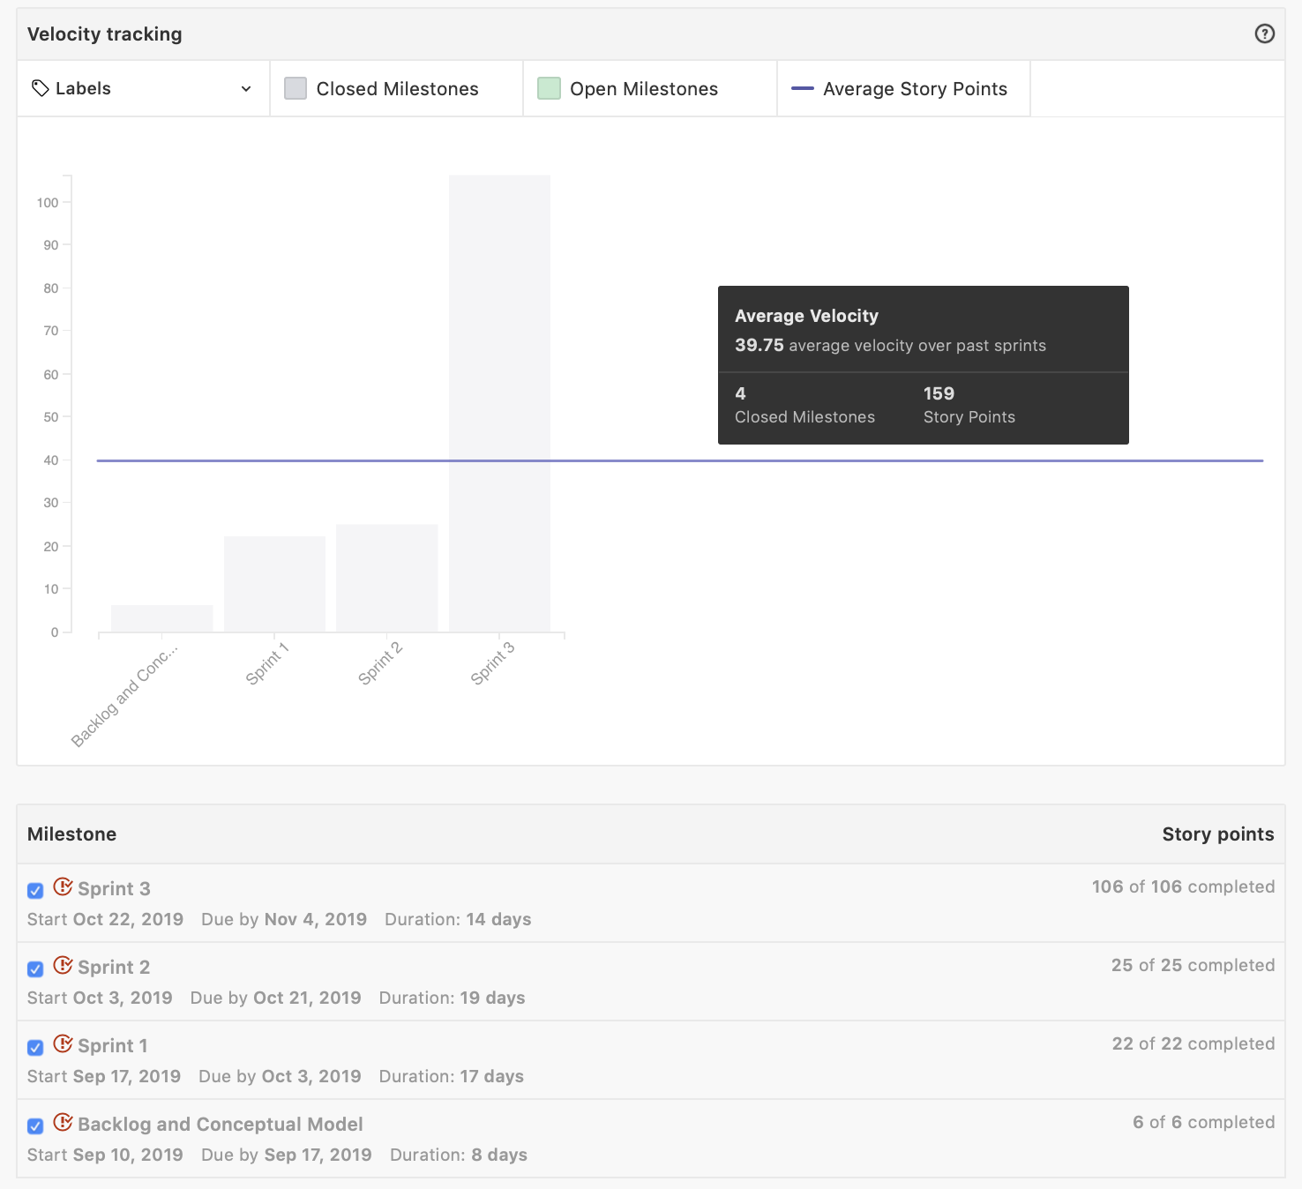
Velocity Chart
Notes:
Paulyn’s Slide
This is our Velocity Chart
We were able to complete all our 106 story points in this sprint
Which brought our average velocity up to 39.75 story points

Slide 6
What is a Food Desert?
Food Deserts are urban neighborhoods and rural towns without access to healthy, fresh, and affordable food.
Approximately 12 million people who live in U.S. food deserts have difficulty accessing healthy food such as, fresh vegetables and fruits.
According to the US Department of Agriculture, living in Food Deserts have been linked to poor diets and greater risk of obesity.
Notes:
Minhaj’s slide
To refresh everyone’s memory on food desert.
A food desert are urban neighborhoods and rural towns without access to healthy, fresh, and affordable food.
Approximately 12 million people who live in U.S. food deserts have difficulty accessing healthy food such as, fresh vegetables and fruits.
According to the US Department of Agriculture, living in Food Deserts have been linked to poor diets and greater risk of obesity.

Slide 7

What is our product?
Oasis
Food
We are developing an Android application called Food Oasis that uses geolocation to help users that live in food deserts search for quality food sources that are available nearby.
Our Android application had features that allow vendors to create an account and display quality food items that are either low cost or free.
Users will also be able to see the vendor’s location details such as phone number, address, working hours and the rating of the vendor’s quality of food.
Notes:
Paulyn’s slide

Slide 8
What is the Value of Food Oasis?
We believe our product is very valuable because of this ongoing dilemma in society. Many people that live in low-income areas are usually in areas called Food swamps.
A food swamp is an area where there is an abundance of fast food, junk food outlets, convenience stores, and liquor stores.
We know that there are many health problems that are associated to eating these type of unhealthy options.
Our technology can raise awareness of healthy food options and reduce risks.
Our application can increase revenue for small vendors and increase their reach in communities.
Notes:
Minhaj’s slide
We believe our product is extremely valuable because this ongoing dilemma persists in society.
People who live in Low-income areas are called Food Swamps.
A food swap is where there is a huge quantity of fast food.
- whether it is in stores or junk food outlets.
Because of this, health problems arise from making unhealthy choices.
Our tech. can raise awareness of healthy foods + reduce risks.
Also, our app can increase revenue for small vendors + increase reach in communities.

Slide 9

TS: Vendors logging into the food oasis application to access the vendor’s homepage.
Is the username textbox prompting the keyboard?
Is the password textbox prompting the keyboard?
Is the keyboard responding to user input?
Are the login and return buttons properly functioning?
Are the user credentials being checked correctly?
Is there an error alert box being prompted when the user inputs incorrect credentials?
Notes:
Paulyn’s slide
This is our first Test Scenario:

Slide 10
TS: A first-time vendor signing up to create an account for the food oasis application.
Is the vendor able to click on each textbox in the signup form and does it prompt the keyboard?
Is the vendor able to click the photo upload does it prompt an option to upload a photo into the sign-up form?
Is the photo displaying in the sign up form after being uploaded?
Is there an error alert box being prompted if an existing vendor account already exists?
Is there an error alert box being prompted if the vendor does not completely fill the sign-up form?
After clicking the sign-up button, does the data properly store into the database and create a new vendor account?
Notes:
Minhaj’s slide
Our second TC scen. Is where a first-time vendor is signing up to create an account for the application.
Talk about the TC’s

Slide 11
TS: A user viewing the list of nearby food vendor locations after inputting their current location
After the user inputs their current location, is there a list of nearby food vendor locations properly being displayed?
Is the list of food locations nearby the user’s inputted current location?
Is the RecyclerView properly functioning when the user scrolls through the list?
Is the user able to click on the food locations?
When a user clicks on a certain food location, is the correct food location details being displayed?
Notes:
Paulyn’s Slide

Slide 12
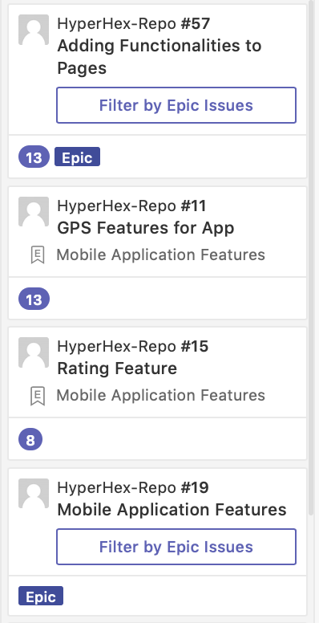
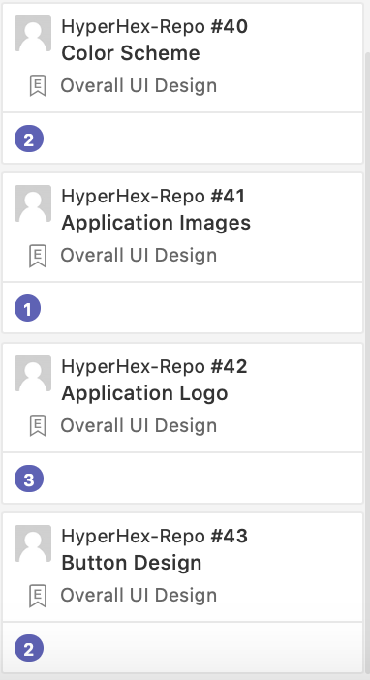
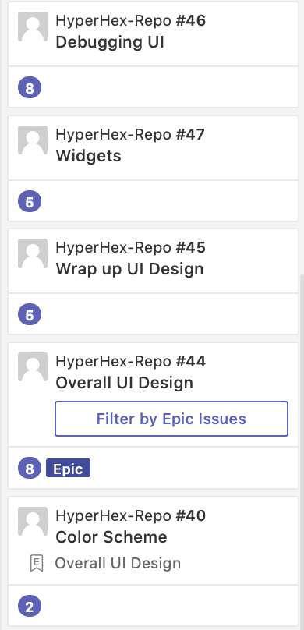
Backlog Stories
Notes:
Minhaj ‘s Slide
These are our backlog stories
As you can see, We still have to add functionalities to our pages
Add Mobile application Features which include
-Rating features
-GPS features
Overall UI Design which include
Color Scheme
Application Images
Application Logo
Button Design
Widgets
By Wrapping up UI Design, we need to make finishing touches to how it looks
Debugging the UI

Slide 13

Any Questions?
Notes:
Paulyn’s Slide

